Slide 1




Strategy Shutdown
Go to Market Strategy:
Intelliswitch
Team: Synergy Seekers
Campus: ISB
Herak
Muskaan
Mahajan
Parth

Slide 2


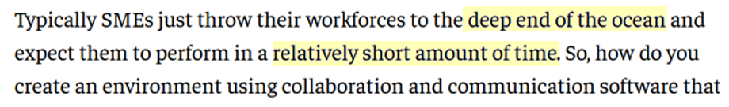
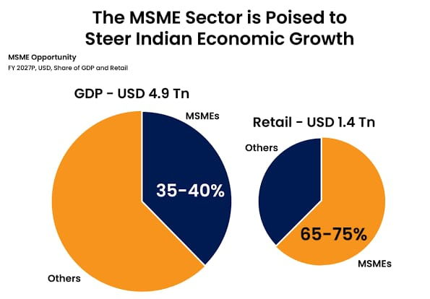
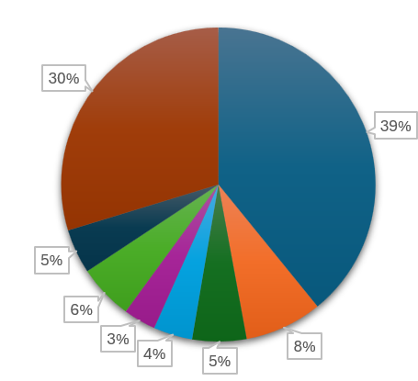

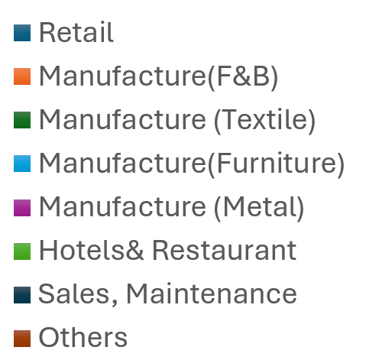

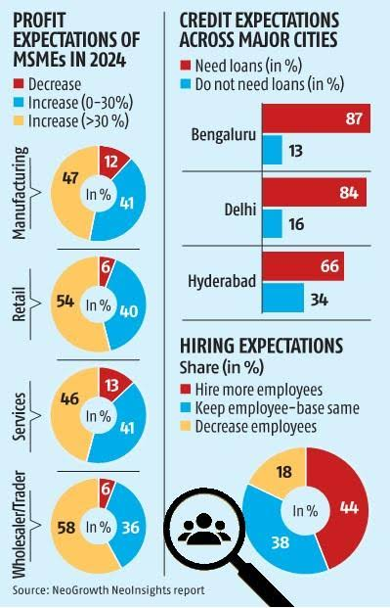
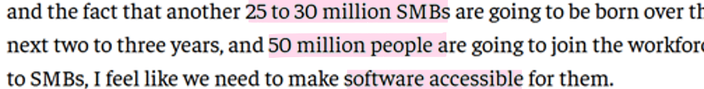
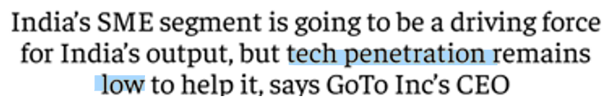
Case Objective
Deliverables
12
1
2
3
Market Study
SME Sectors
Major Concerns
for SMEs

Slide 3






ANALYSING THE PRODUCT MARKET FIT ACROSS FRAMEWORKS
Pain Points for SMEs
Value Proposition Model
PRODUCT
CUSTOMER
Porter’s Five Force Model
Buyer Persona & Product Positioning
TO BE FILLED
Competition
Threat of New Entrants
Threat of Substitutes
Threat of Buyers
Power of Supplier

Slide 4
CUSTOMER ACQUISITON JOURNEY
Awareness
Retention
Evaluation
Subscription
RESEARCH
EVALUATION
SUBSCRIPTION
RETENTION

